Slide 1

Leaders in Environment Analysis and Definition of Strategy

Slide 2

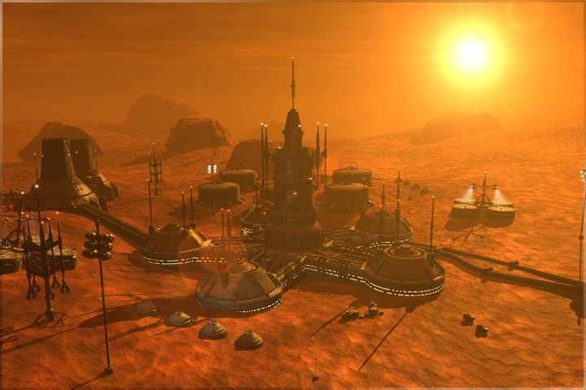


Slide 3
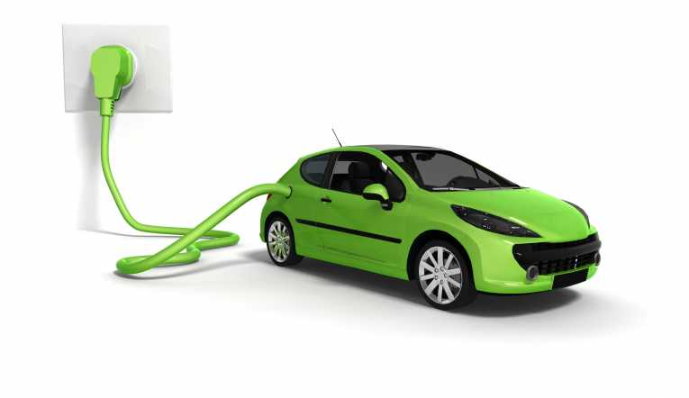

Slide 4
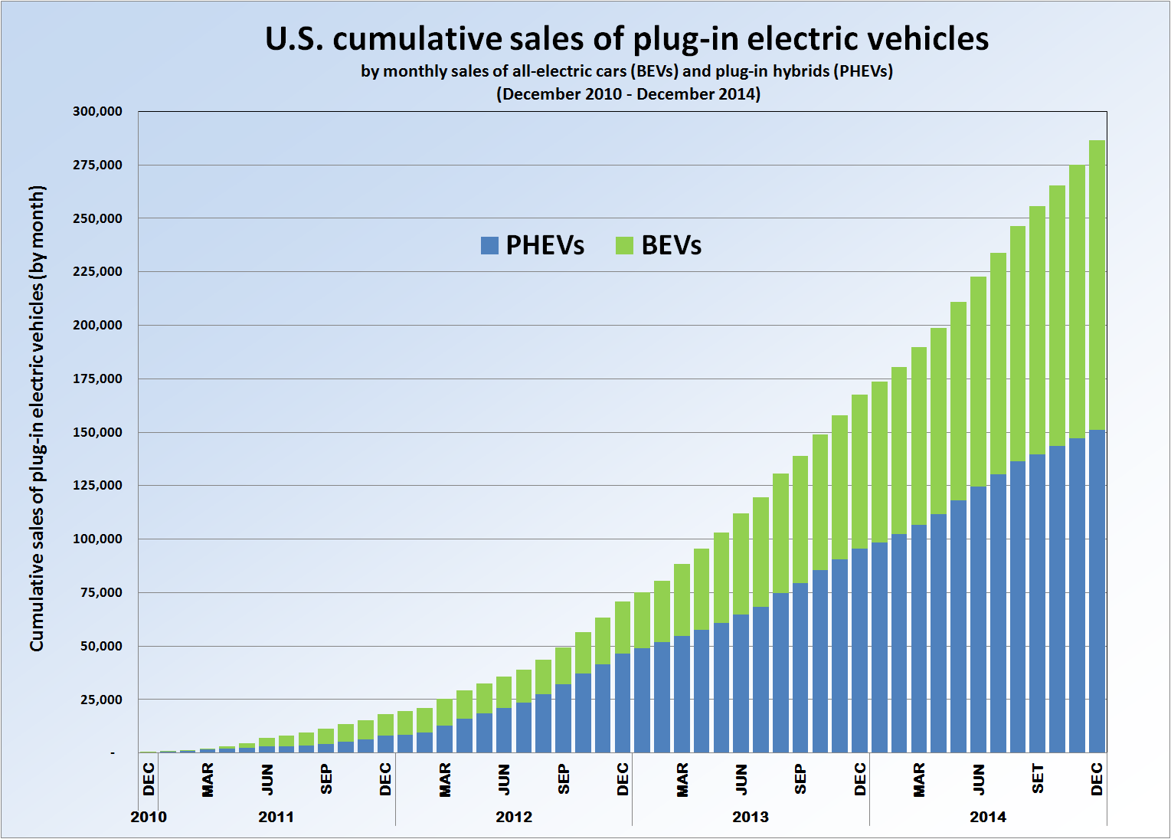

Slide 5
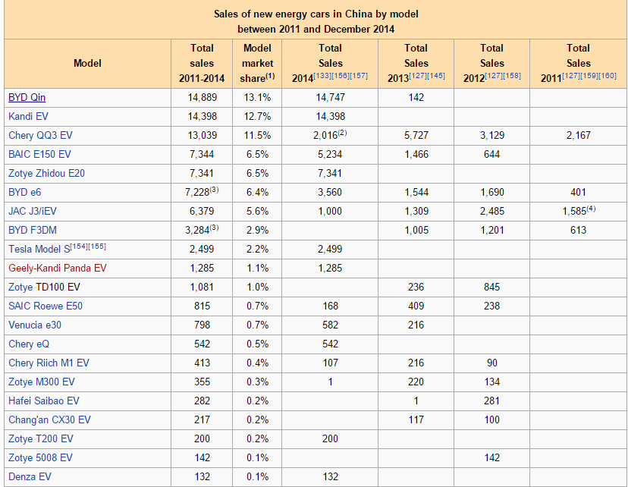

Slide 6
[Emre, Insert the video here]

Slide 7
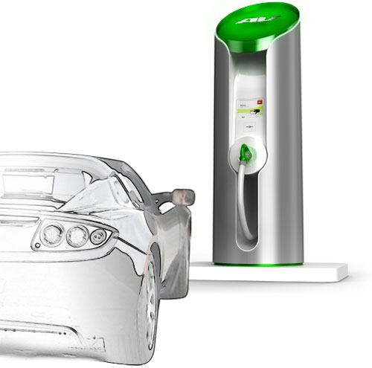
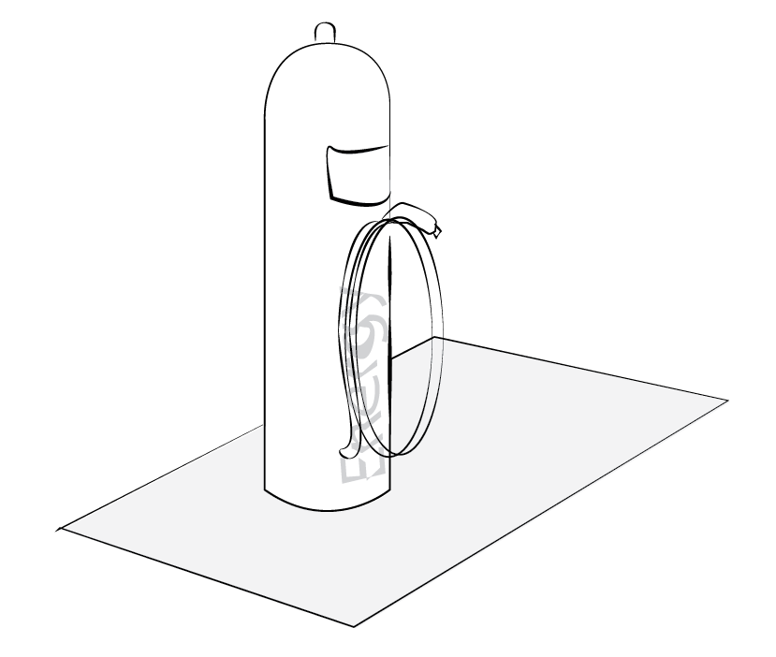
Source: http://www..clubcandoca.com.br

Slide 8
Electrical Car Charging
Connecting
The Grid
Accessibility
Environment
Energy distribution
Data Technology

Slide 9
[Our Project Model]

Slide 10
Input
Output
Participants
The team
The support from the professor, the TA, and their contacts (technical assistance
A one semester-long course
Infrastructure of Tsinghua University
Professor
Companies in the field of electric chargers, oil suppliers, electricity, individuals
Our team
Provide an open-sourced Industrial Analysis Report.
Market
Research
Investment
Manufacturing
Suppliers
Stakeholder
Infrastructure
Law
Public policy
Current challenges
Society acceptance
Deliver a recorded presentation of the project

Slide 11
Short-term
Medium-
term
Long-term
We as a team know better each other
Improved knowledge about the management of a project and its different tools
A good mark for the course
Get inspired by this market for our career
Companies develop better strategies and decisions about this market
Help new innovative companies enter the market
Implementation of the acquired skills in internship, job and other projects
Increased feasibility, reliability of electric cars
Increased development of the electric car market and charging stations market
Better environment due to the decrease of emissions

Slide 12
[Based on the following]

Slide 13
External Factors
Assumptions
We can work correctly together
We can be interested in the subject for the semester
The resources are adequate and available
The companies know about the existence of this industrial analysis report
This industrial analysis report is relevant and useful for companies
The developments of technology in the vehicle market and their relevance, f.e.:
Hybrid technology
Electric technology
N₂ technology
Other technologies

Slide 14
Leaders in Environment Analysis and Definition of Strategy

